Slide 1

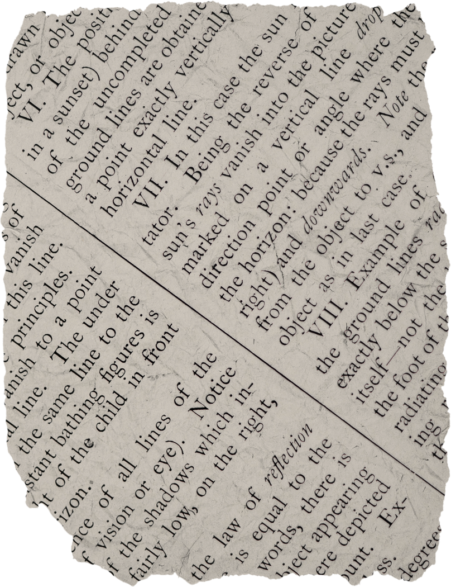
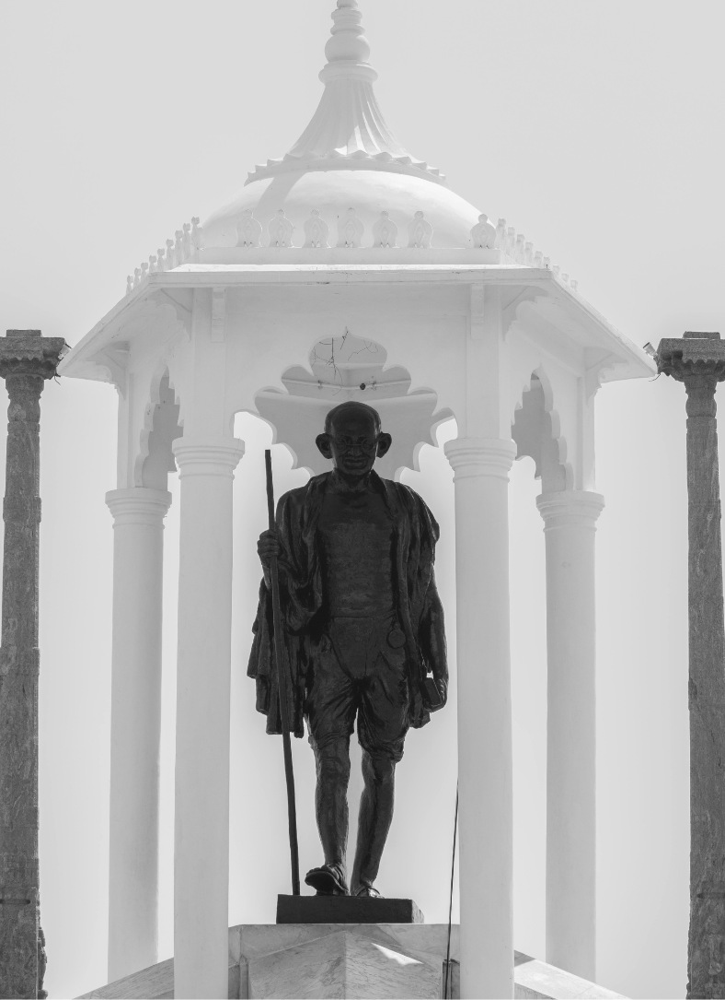




CILAMBARASAN A
Mahatma Gandhi
NIVETHAN RAAJ P
TAMEEM AHMED S
Living the Gandhian Way: Truth, Non-Violence
Sujith S

Slide 2
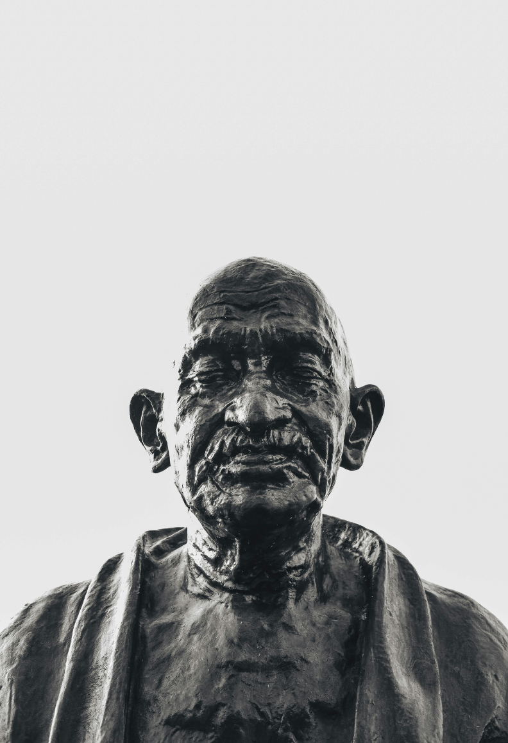
Introduction to Gandhi’S Principles
Gandhi emphasized truth and non-violence as essential for integrity and peaceful coexistence. He viewed truth as the basis of moral values and non-violence as a powerful tool for social change, inspiring individuals to promote justice, empathy, and respect for all human life.

Slide 3
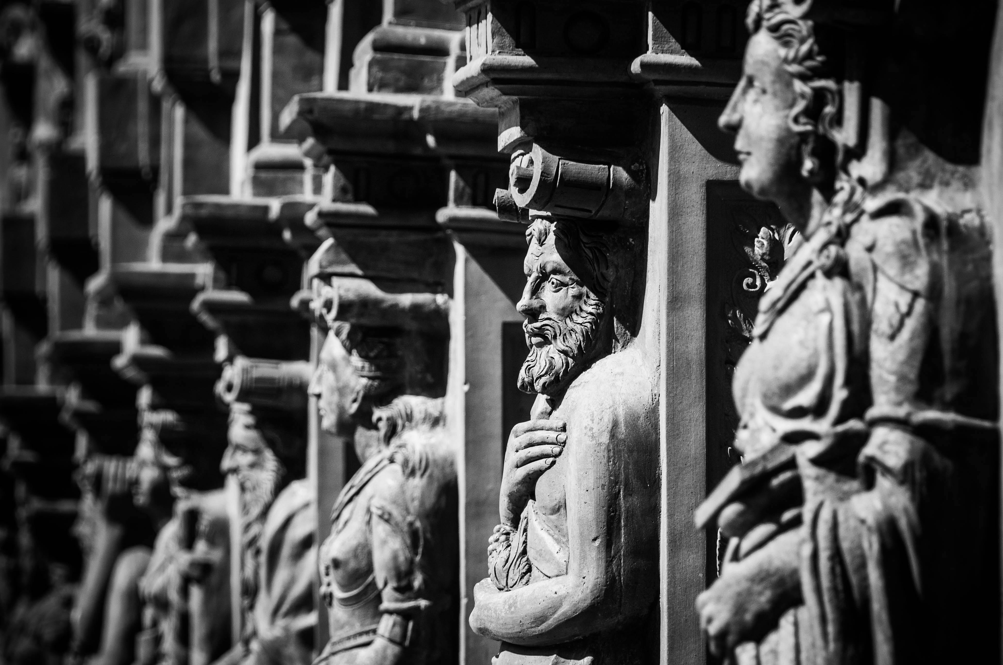

Understanding Truth
At the heart of Gandhi's philosophy is truth. He believed that living truthfully leads to authenticity and integrity. In our daily lives, embracing truth can enhance our relationships and decisions. It's about being honest with ourselves and others, fostering a sense of trust.

Slide 4
The Power of Non-Violence
Non-violence is not just the absence of conﬂict; it's a proactive approach to compassion and understanding. Gandhi taught that responding to violence with love can transform situations. We can practice non-violence in our words and actions, promoting peace in our communities.

Slide 5

Everyday Applications
Living the Gandhian way means integrating truth and non-violence into our daily routines. This can be as simple as practicing active listening or choosing kindness in challenging situations. Small actions can lead to signiﬁcant changes in our lives and the world around us.

Slide 6

Promotion of Health and Hygiene:
Gandhi emphasized the importance of sanitation and health, which led to improvements in public health practices and awareness about hygiene in India.

Slide 7
Simplicity and Minimalism
Gandhi’s belief in leading a simple life with minimal possessions, focusing on the essentials to avoid materialism and reduce the impact on the environment.

Slide 8

Challenges We Face
Applying Gandhian principles can be tough in today's fast-paced world. Temptations to stray from truth or react violently are everywhere. However, recognizing these challenges is the ﬁrst step to overcoming them.

Slide 9

Inspiring Examples
Many modern leaders and movements draw inspiration from Gandhi's teachings. Figures like Martin Luther King Jr. and organizations like non-violent protest groups continue to advocate for justice through peace. Their stories remind us that the Gandhian way is alive and relevant today.

Slide 10
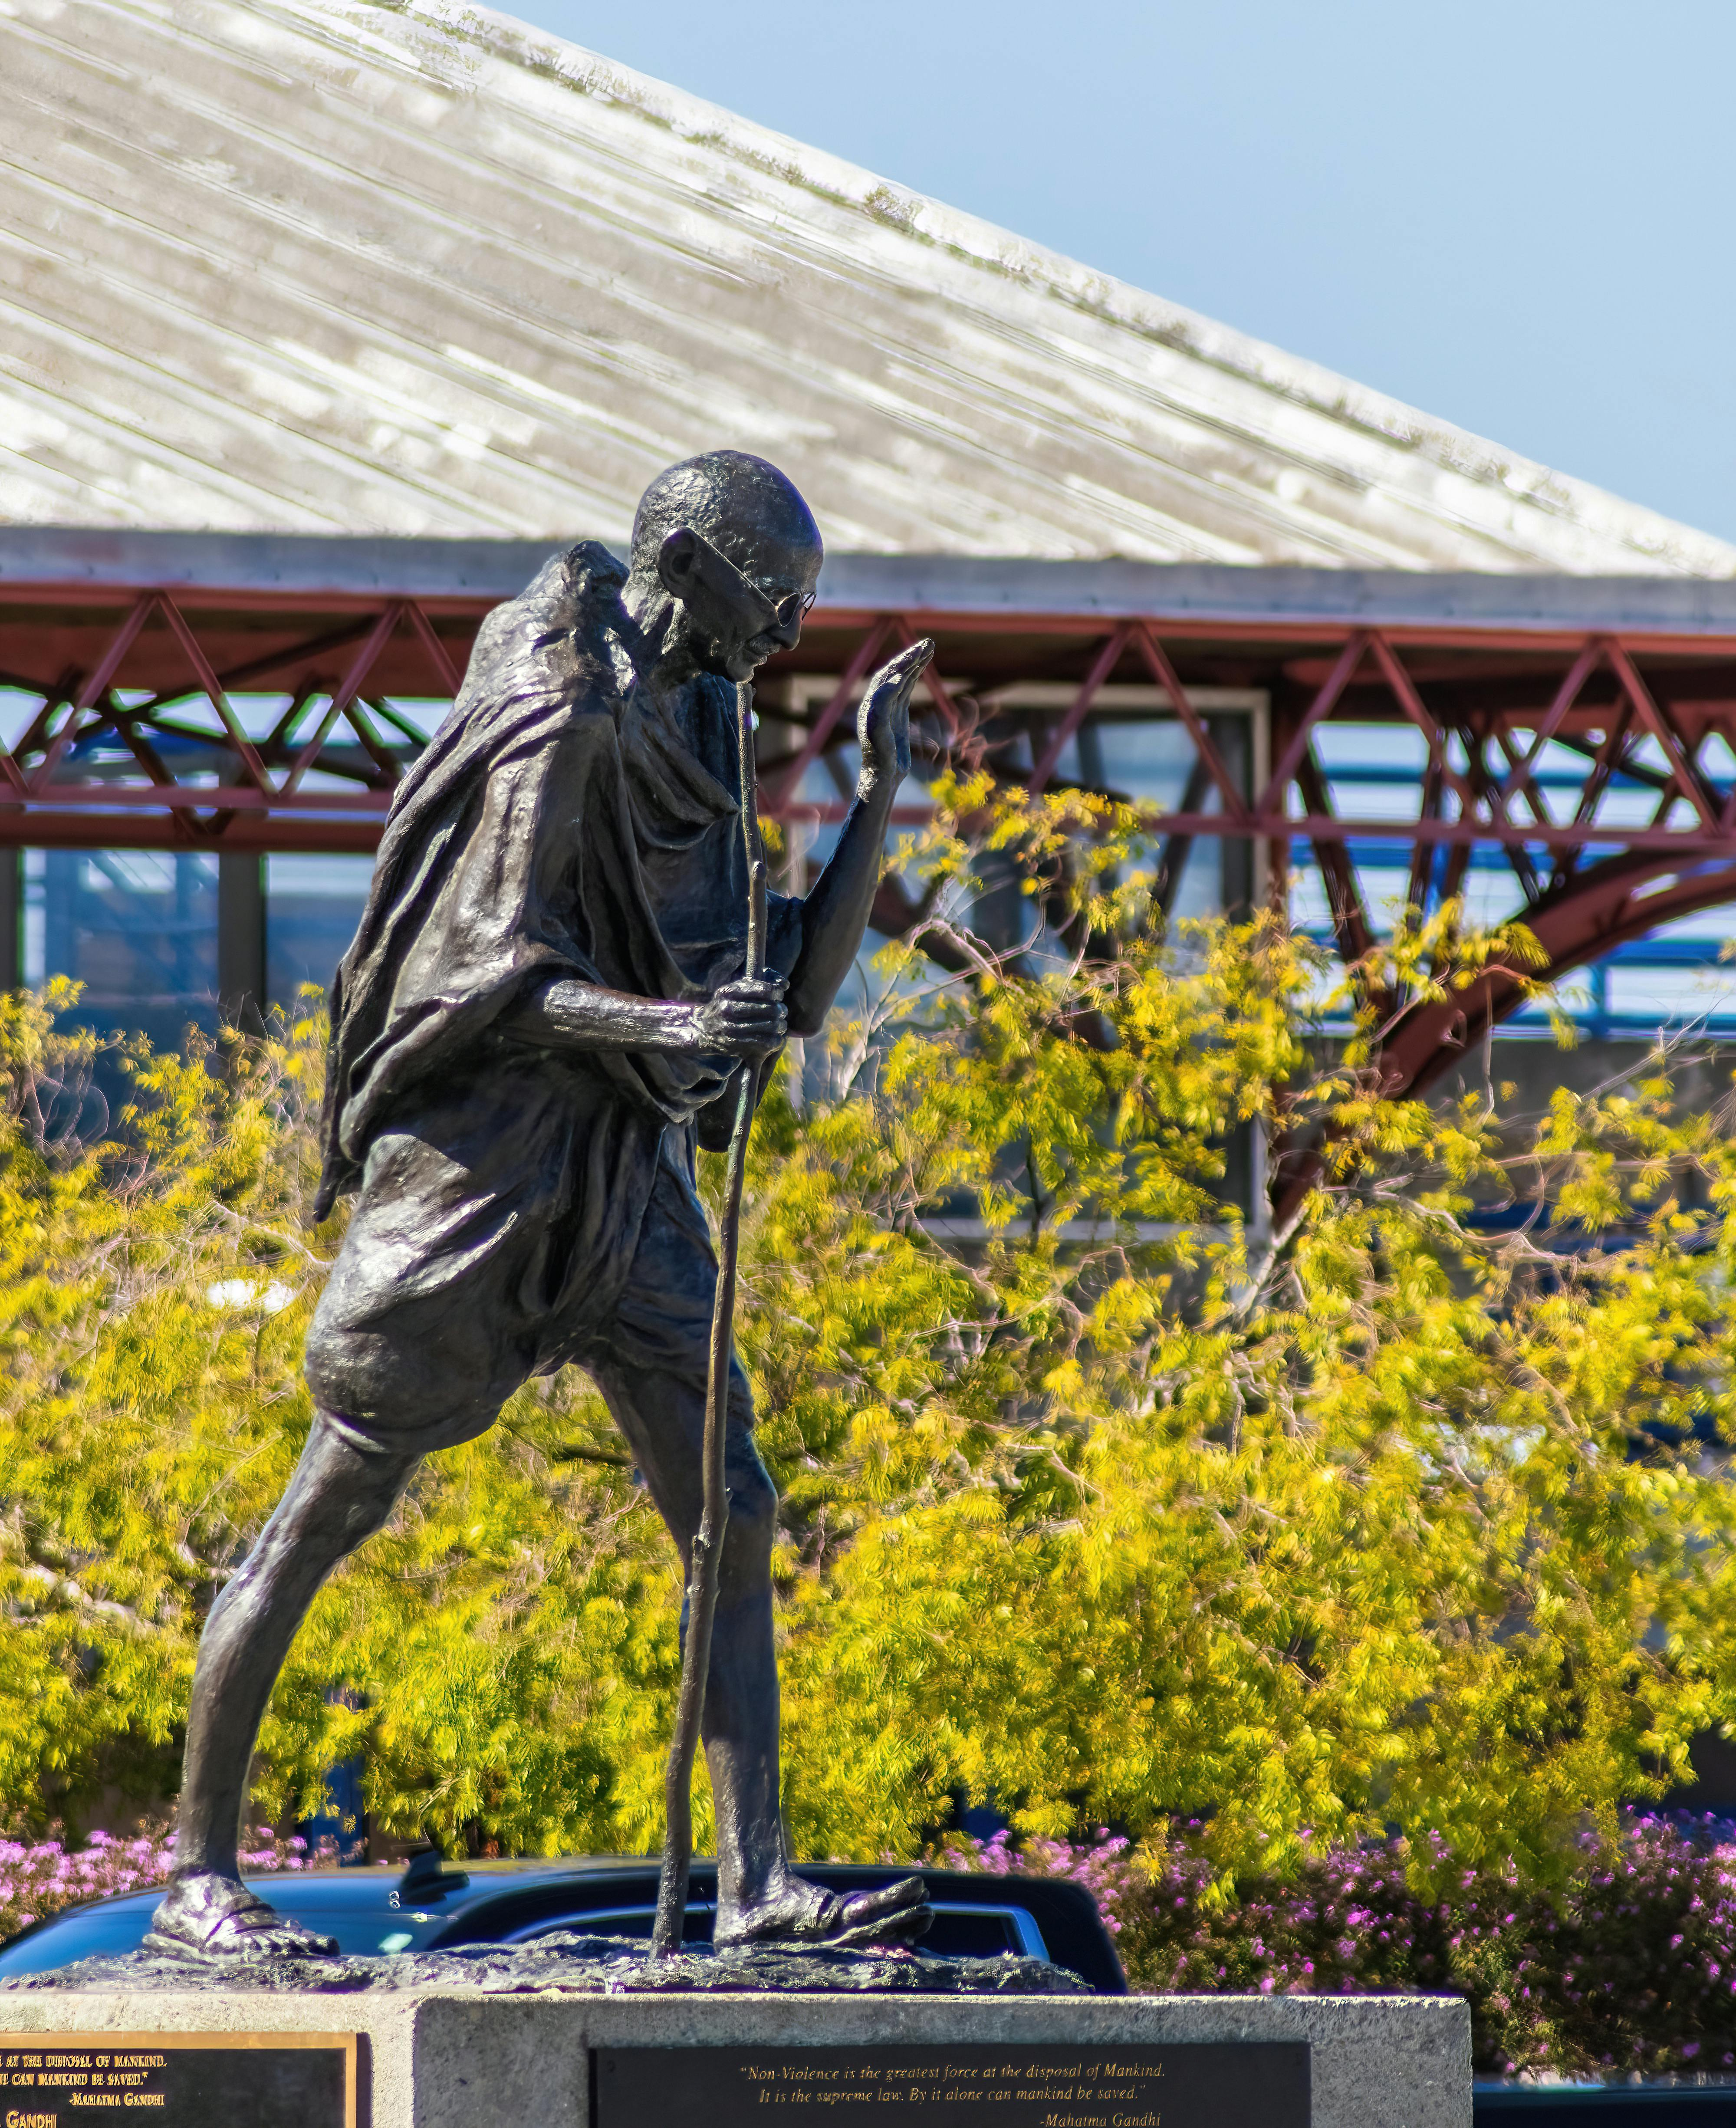
Summary: Live the Gandhian Way
Embracing truth and non- violence can greatly impact our lives and the world. By adopting these principles, we foster compassion and inspire a more peaceful society for future generations.

Slide 11
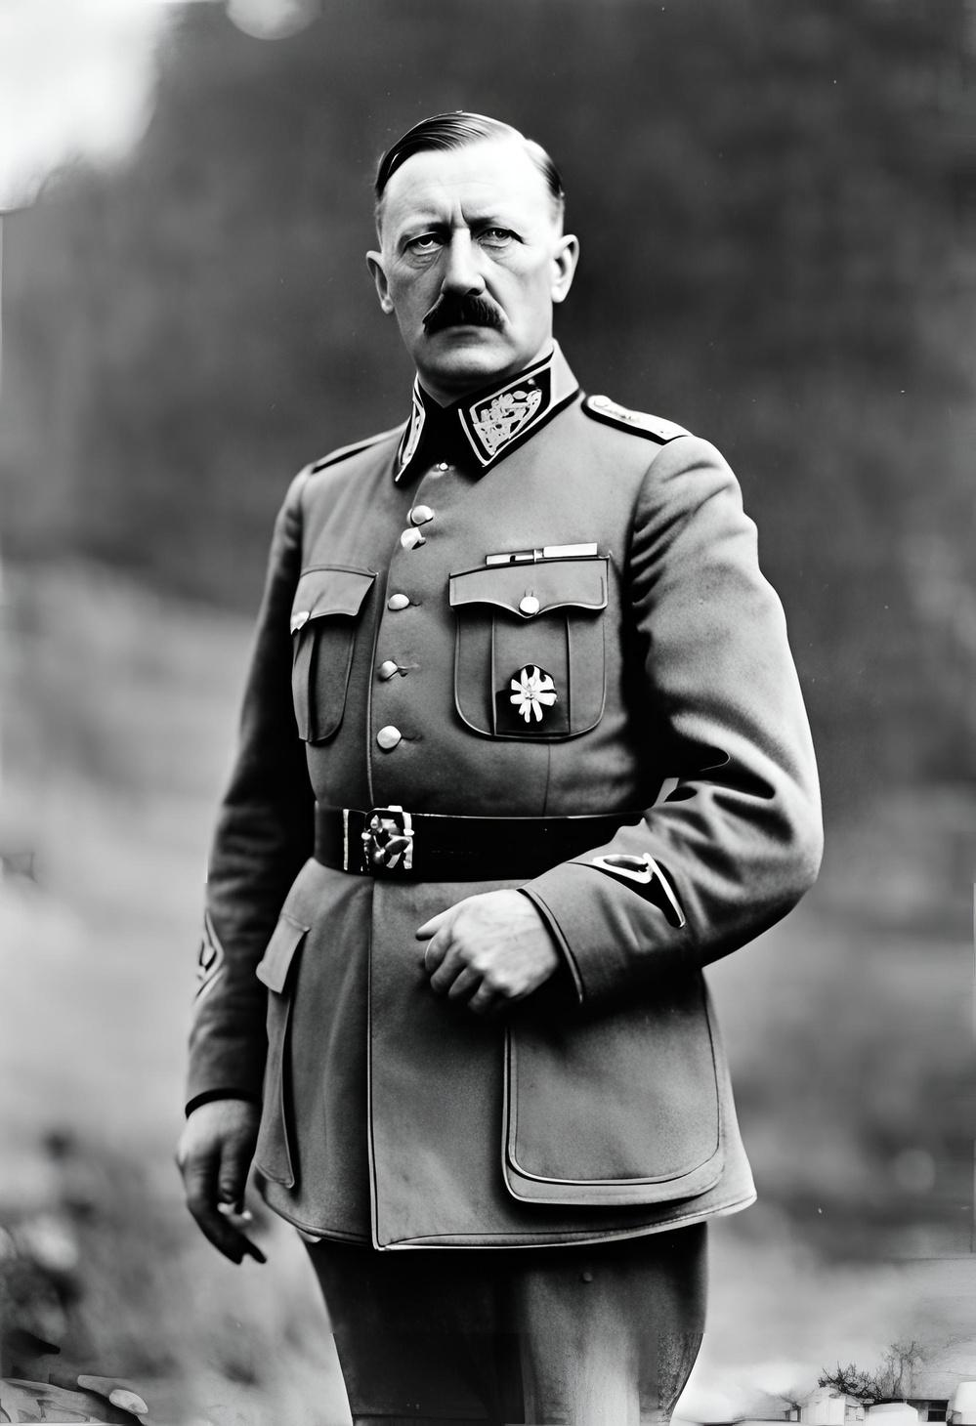
Adolf
Hitler
Two Paths, Two Legacies: The Ideological Divide Between Hitler and Gandhi

Slide 12
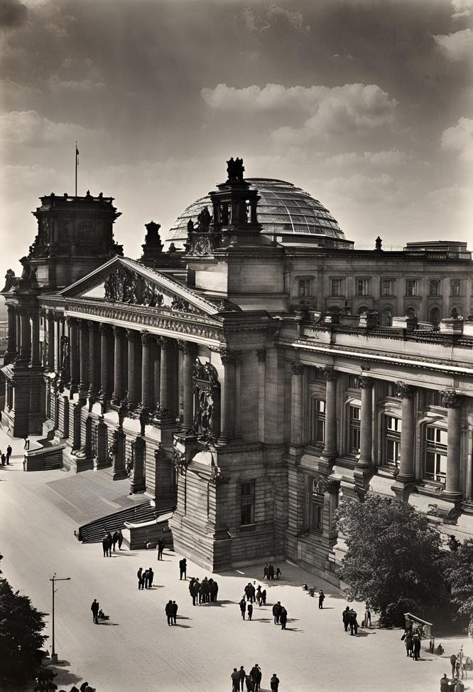
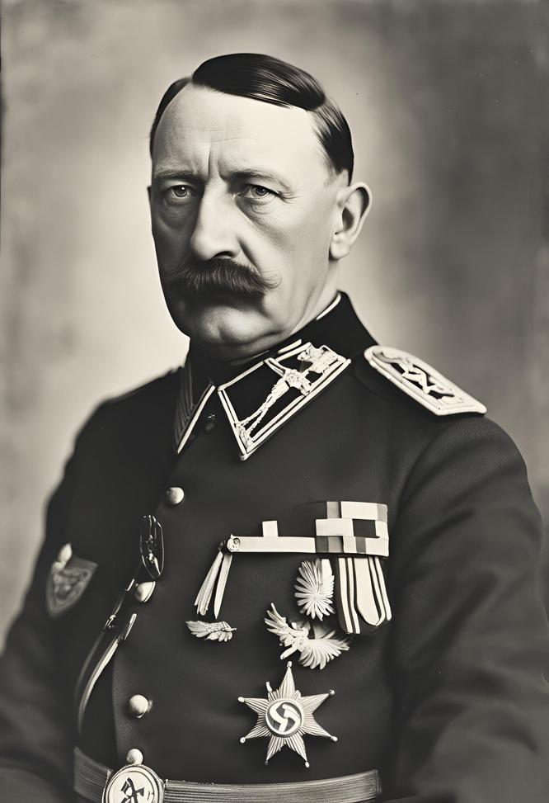
Understanding
the Context
Adolf Hitler, the leader of the Nazi Party, rose to power in Germany during a tumultuous period in history. Understanding the political, economic, and social context of the time is essential to comprehend the factors that contributed to his rise to power and the catastrophic consequences of his reign.

Slide 13
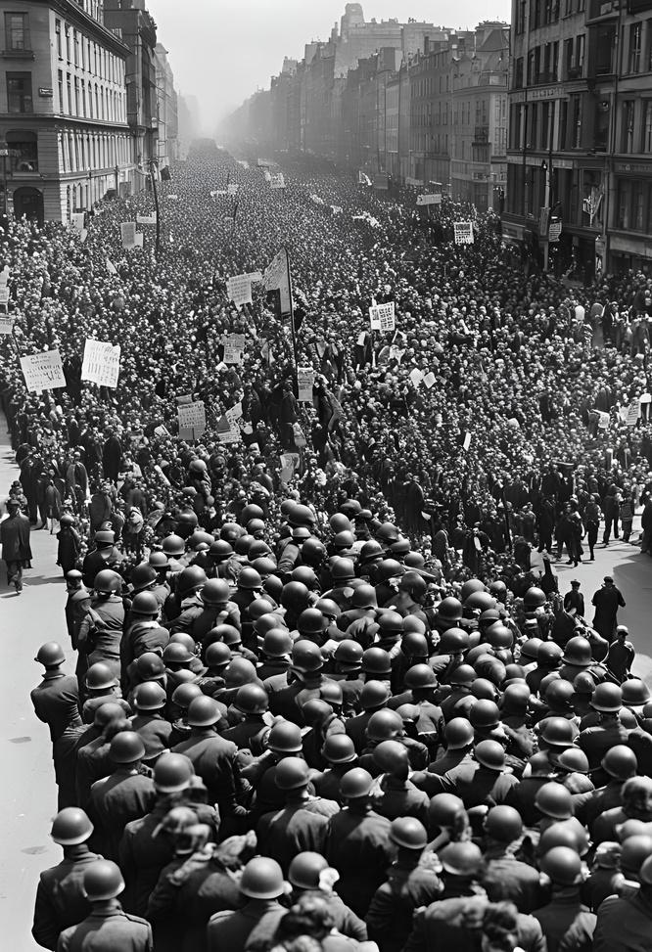
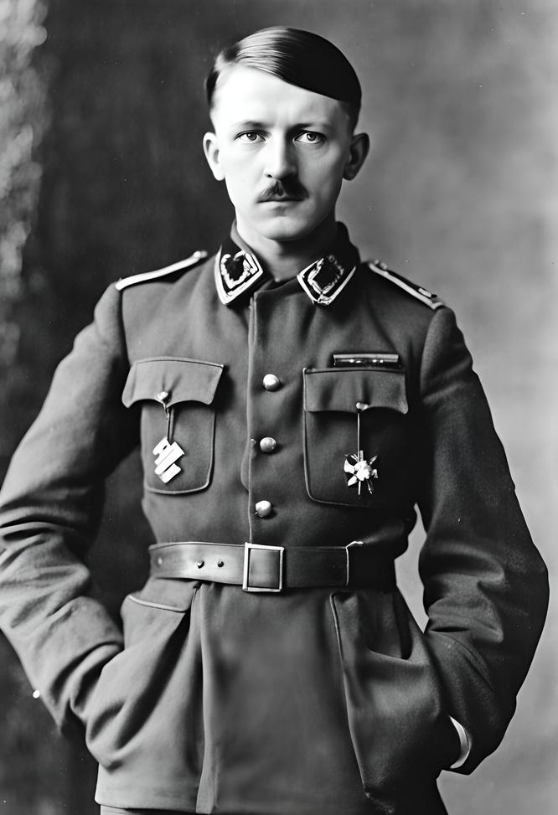
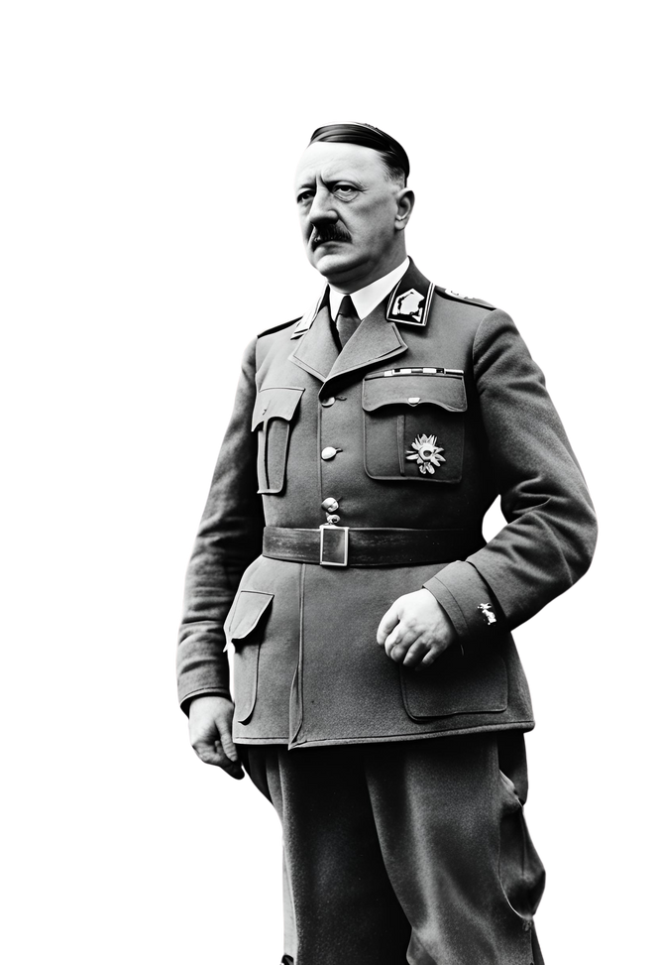

Early Life
The Making of a Dictator
Adolf Hitler, the leader of the Nazi Party, rose to power in Germany during a tumultuous period in history. Understanding the political, economic, and social context of the time is essential to comprehend the factors that contributed to his rise to power and the catastrophic consequences of his reign.

Slide 14
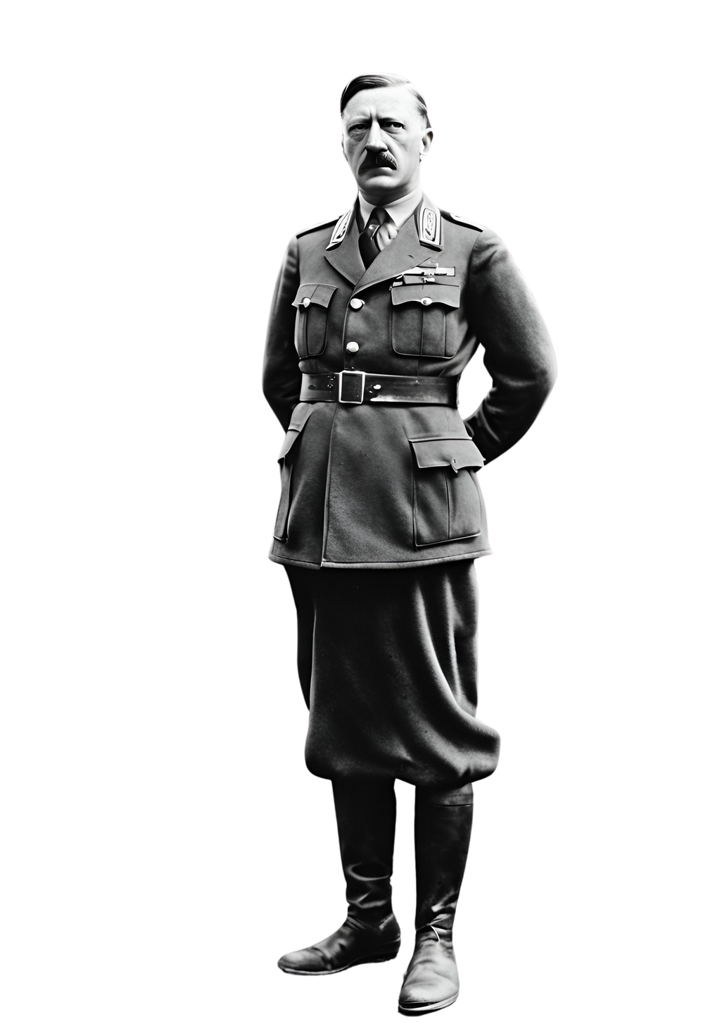
From Chancellor
to Dictator
In 1933, Hitler was appointed Chancellor of Germany by President Paul von Hindenburg. Using legal and political maneuvers, as well as intimidation and violence, Hitler swiftly consolidated his power and eliminated political opposition.
The Reichstag Fire Decree and the Enabling Act granted Hitler dictatorial authority, effectively marking the end of democracy in Germany and the beginning of Nazi tyranny.

Slide 15
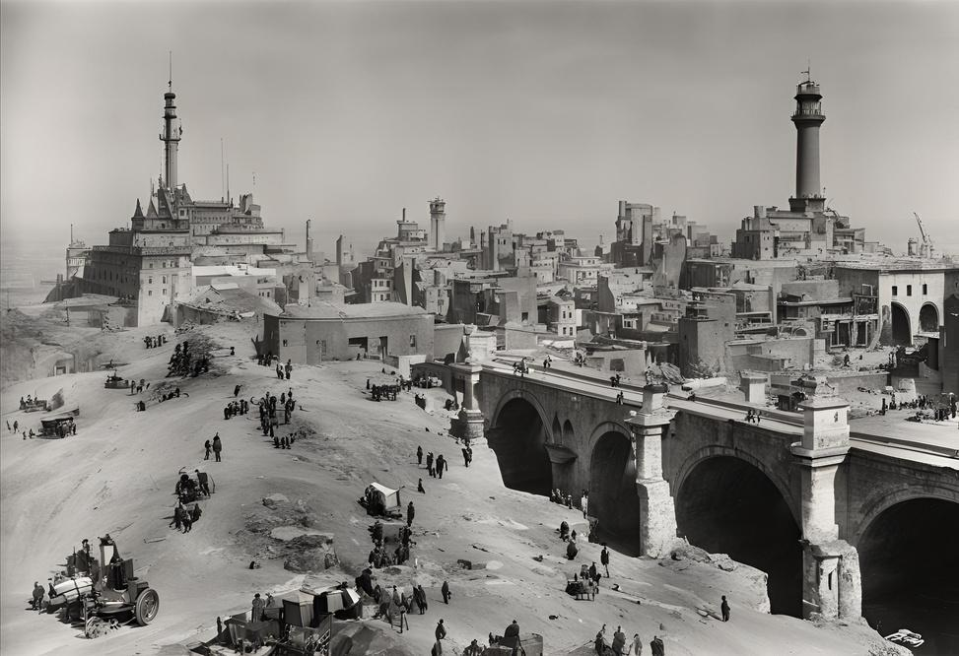
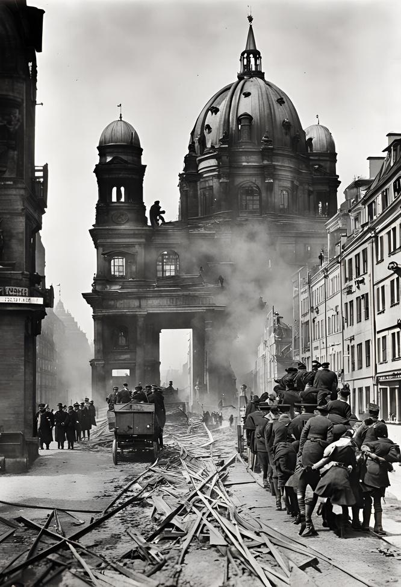
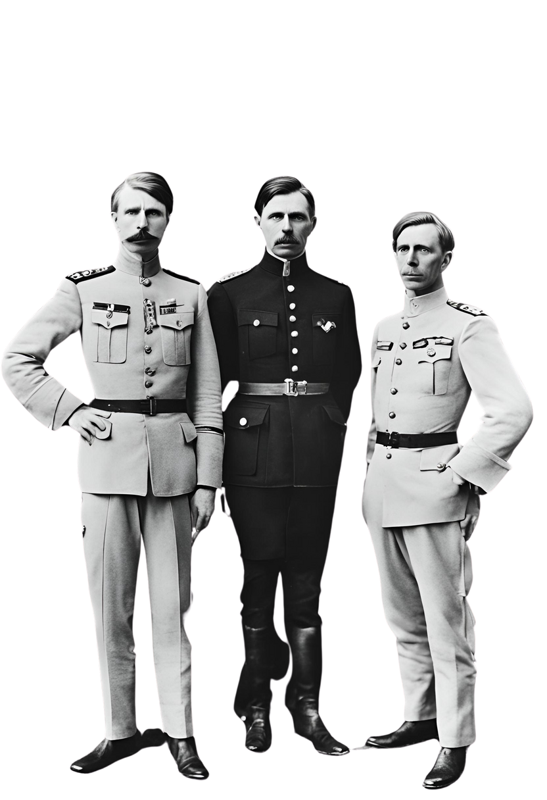
World War I
The Great War and Its Aftermath
During World War I, Hitler served as a soldier in the German army, where he was decorated for bravery and wounded in combat. The war's end in 1918 left Germany in a state of political and economic turmoil, with widespread discontent and social unrest. Hitler's experiences during the war and its aftermath would later fuel his political ambitions and extremist ideologies.

Slide 16
The Rise of the Nazi Party
Post-War Turmoil:
Germany faced instability and economic hardship after World War I, creating a breeding ground for discontent and radical ideologies.
Hitler's Ideology:
Adolf Hitler capitalized on this unrest, promoting nationalist and
anti-Semitic beliefs that resonated with disillusioned citizens.
Party Formation:
In 1919, Hitler joined the German Workers' Party, which later transformed into the National Socialist German Workers' Party, or Nazi Party.
Hitler's Leadership:
Through impassioned speeches, and extreme ideology, he quickly rose to prominence within the party, laying the groundwork for his rise to power.

Slide 17
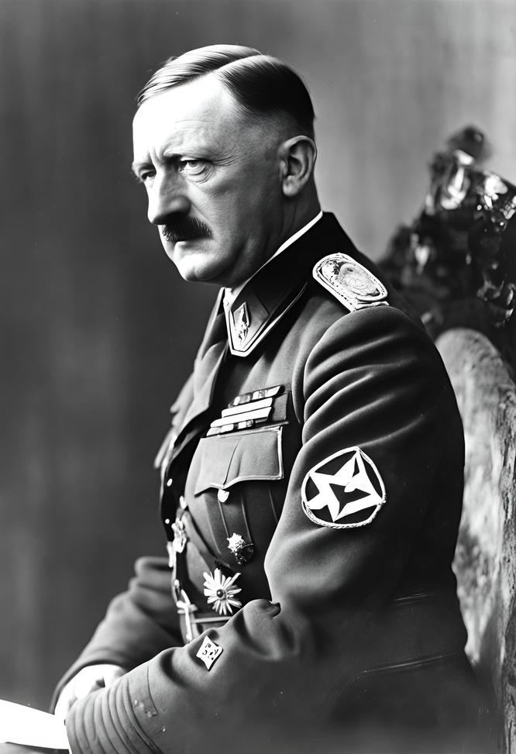
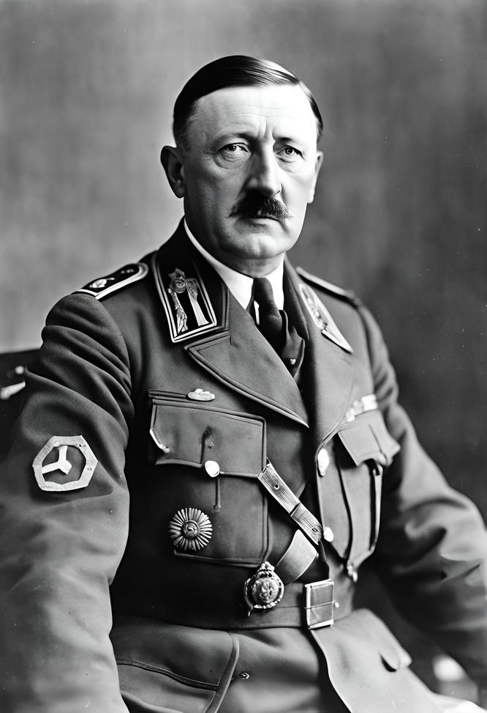
Appointment as Chancellor
Consolidation of Power
In 1933, Adolf Hitler was appointed Chancellor of Germany by President Paul von Hindenburg, leveraging his growing influence within the Nazi Party.
Through legal and political maneuvers, intimidation, and violence, Hitler swiftly eliminated political opposition and consolidated his power, centralizing authority under the Nazi regime.
Reichstag Fire Decree and Enabling Act
Hitler exploited the Reichstag fire in February 1933 to push through the Reichstag Fire Decree, suspending civil liberties and enabling the suppression of political opponents. Subsequently, the Enabling Act granted Hitler dictatorial authority, effectively ending democracy in Germany and paving the way for Nazi tyranny.

Slide 18
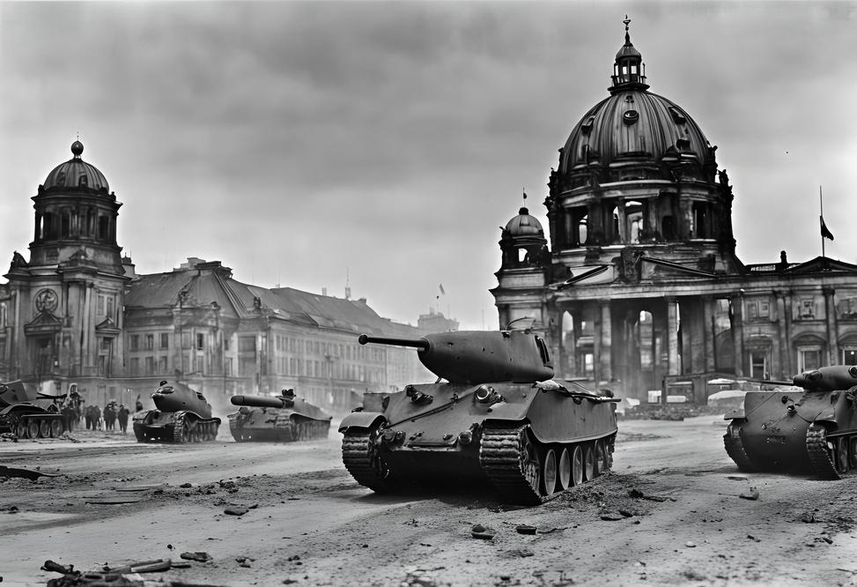
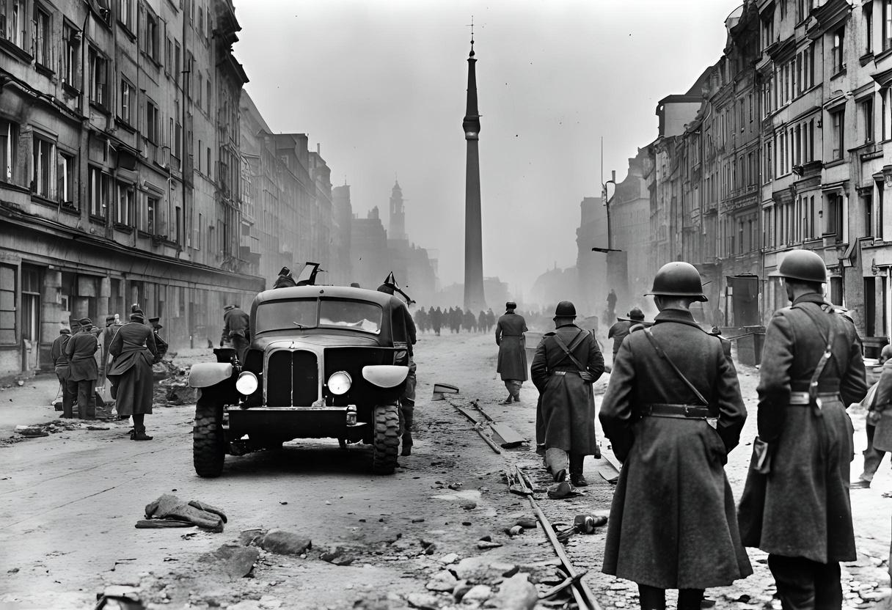
World War II
Hitler's expansionist ambitions and aggressive foreign policies precipitated the outbreak of World War II in 1939. The conflict engulfed much of the world, resulting in unprecedented devastation, loss of life, and suffering.
Hitler's military strategies and atrocities, including the invasion of Poland, the Blitzkrieg, and the Holocaust, left an indelible mark on history and forever changed the course of the 20th century.

Slide 19
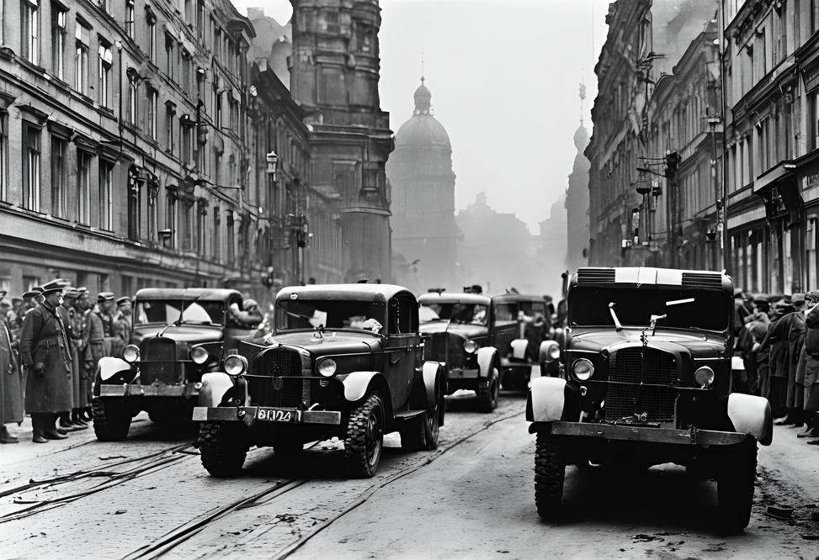
Defeat
and Damnation
As Allied forces advanced on Germany, Hitler's regime crumbled under the weight of defeat. On April 30, 1945, facing certain capture, Hitler committed suicide in his bunker in Berlin. The end of the war marked the defeat of Nazi Germany and the liberation of Europe from tyranny. Hitler's legacy remains one of infamy and horror, serving as a stark warning of the dangers of unchecked authoritarianism, extremism, and hatred.

Slide 20
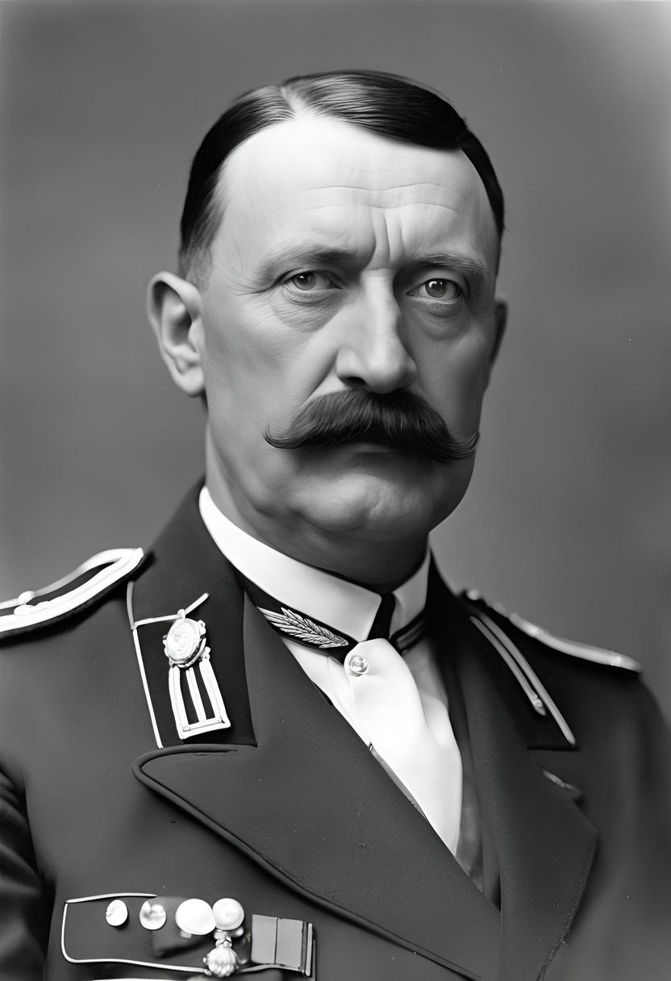
Remembering
the Past
As we conclude our journey through the life and legacy of Adolf Hitler, let us reflect on the profound impact of his reign of terror and the lessons learned from this dark chapter in history. May we remain vigilant against the forces of hatred and extremism, and strive to build a world guided by tolerance, compassion, and respect for all humanity.

Slide 21
Hitler: The Tyrant’s Reign,
Gandhi: The Peaceful Revolution.

Slide 22
Approach to Power
Hitler's Ideology:
Advocated for authoritarianism and totalitarian control, using fear, propaganda, and violence to maintain power.
Gandhi's Ideology:
Promoted democracy and self-rule, emphasizing civil disobedience and nonviolent resistance.

Slide 23
Philosophy on Violence
Hitler's Ideology:
Believed in the use of force and militarism to achieve and maintain objectives.
Gandhi's Ideology:
Firmly adhered to ahimsa (nonviolence) and believed that true change could only come through peaceful means.

Slide 24
Racial and Social Views
Hitler's Ideology:
Endorsed racial superiority, specifically Aryan supremacy, and implemented policies of racial discrimination and genocide.
Gandhi's Ideology:
Advocated for the equality of all races and social classes, fighting against discrimination and promoting universal brotherhood.

Slide 25
Economic and Social Policies
Hitler's Ideology:
Emphasized a centralized economy focused on war production and territorial expansion.
Gandhi's Ideology:
Supported a self-sufficient village economy, promoting sustainable living and economic independence.

Slide 26
Vision for Society
Hitler's Ideology:
Sought to create a homogeneous society based on racial purity and nationalistic ideals.
Gandhi's Ideology:
Envisioned a pluralistic and inclusive society where different religions and cultures coexisted harmoniously.

Slide 27

That concludes our presentation.
Thank You
Scan Here to get
The copy of the Presentation.

